Slide 1

RTX-Team A
About Us
Portfolio
Contact Us
Search
County-Level Air Quality Prediction (CLAP)
Launch Demo
SE 4485.001 – Group 1:
Sponsor(s):
Merc Perna, TD
Trey Williams, C/E
Ryan Havens, SE
Trevor Lang, EA
Student(s):
David Santos
Amelia Quinn
Kevin Melo
AJ Kimbrough
Andrew Enright
Jay Chung
Instructor(s):
Dr. Eric Wong
Zizhao Chen
Chih-Wei Hsu

Slide 2

RTX-Team A
About Us
Portfolio
Contact Us
Search
Technical
Feasibility
Prototype
Forecasts tomorrow’s average AQI :
End-to-end machine-learning (ML) predictive model
Predicts Air Quality Index (AQI) by county location
Uses data from the U.S. Environmental Protection Agency (EPA)

Slide 3

RTX-Team A
About Us
Portfolio
Contact Us
Search
Project
Objectives
Data Pipeline:
Data persistence (CSV, artifacts)
ML Model:
Time-series regression model
Leaf-wise gradient boosting framework
Dashboard:
Refresh control workflow
WCAG 2.1 AA compliant

Slide 4
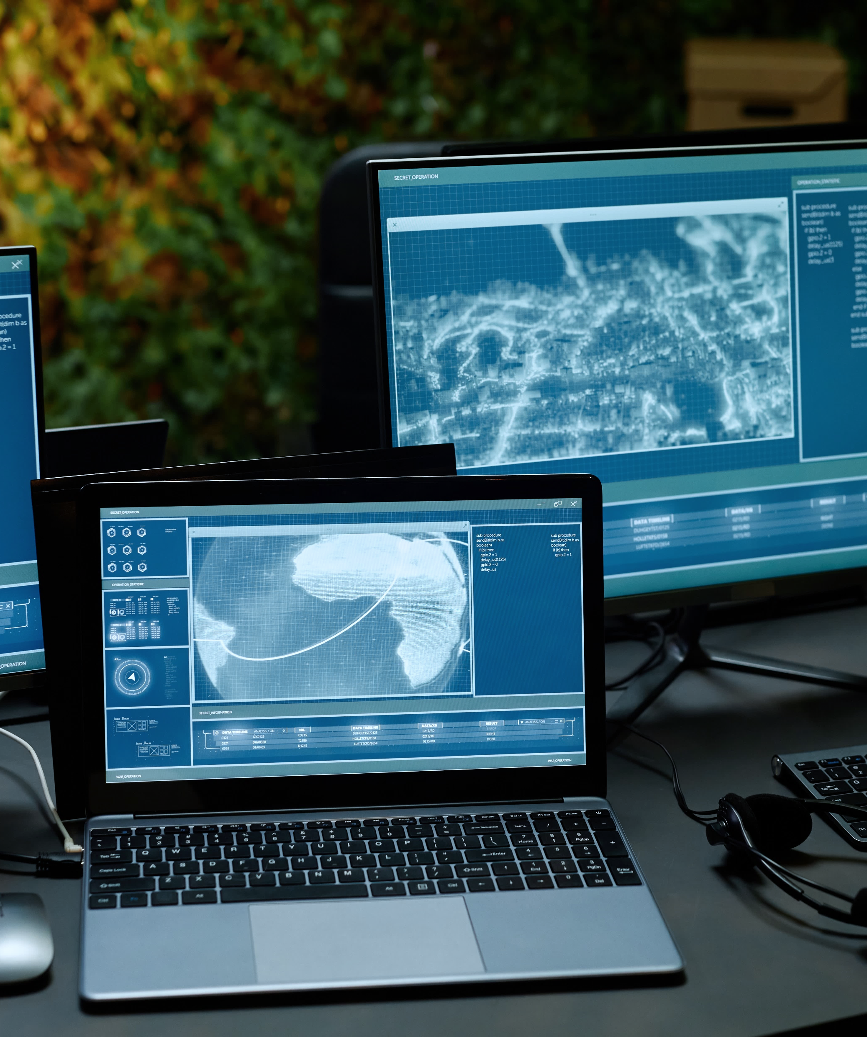



RTX-Team A
About Us
Portfolio
Contact Us
Search
Development
Process
Project Coordination:
Weekly Sponsor Meetings
Project Visibility
Effective communication
Process Engineering:
Incremental development cycles
Iterative ML model lifecycle
Configuration Management:
GitHub

Slide 5
RTX-Team A
About Us
Portfolio
Contact Us
Search
Use Case
UC-1: Ingest Daily AQI
Scenarios
The maintainer manually updates ML-ready AQI dataset using the ingestion deployment pipeline.
Captures the following functional & non-functional requirements:
Data ingestion
Data processing
Predictive analytics
Dashboard interface.
UC-2: Provide County-Level Forecast
System allows end user to obtain a next-day average AQI forecast on demand and view recent county-level AQI trends.

Slide 6
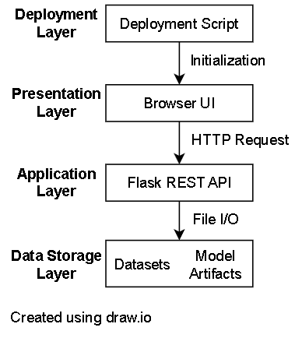
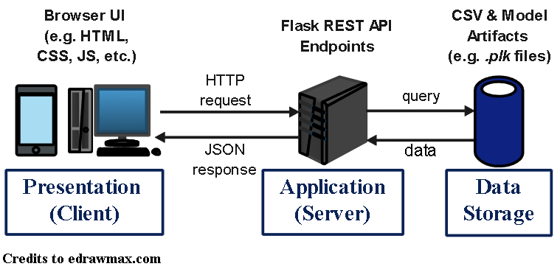

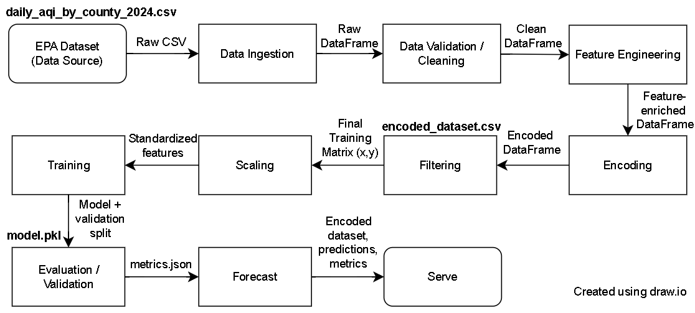


RTX-Team A
About Us
Portfolio
Contact Us
Search
System
Architecture
Layered Architecture
Data Storage
Application (Backend)
Presentation (Frontend)
Client-Server Architecture
Package-level decomposition
Stereotype: <<subsystem>>
Pipe & Filter Architecture (UC1)
Ingestion & Processing
Feature Engineering

Slide 7
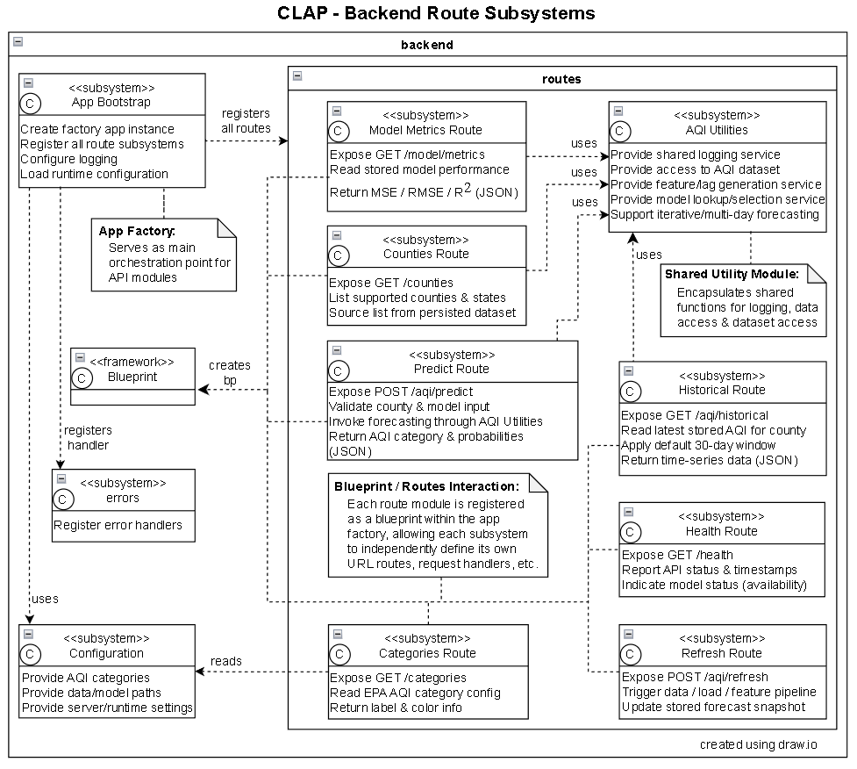


RTX-Team A
About Us
Portfolio
Contact Us
Search
Design:
Static Models
Backend Route Subsystems
Backend API components
Domain DTO
Route-specific JSON responses

Slide 8
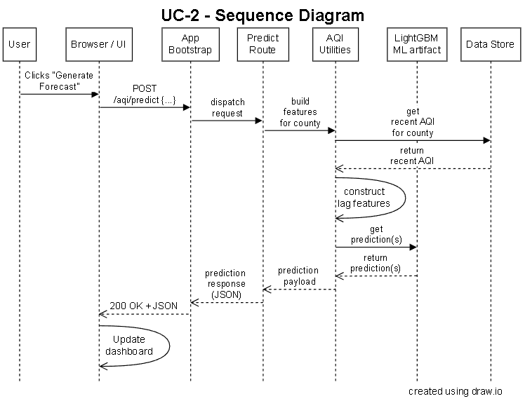

RTX-Team A
About Us
Portfolio
Contact Us
Search
Design:
Dynamic Models
Generate Forecast (UC2)
Runtime interactions (backend APIs/JSON)

Slide 9
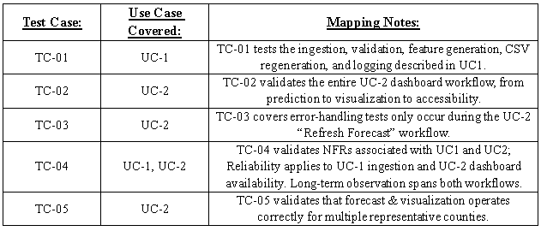

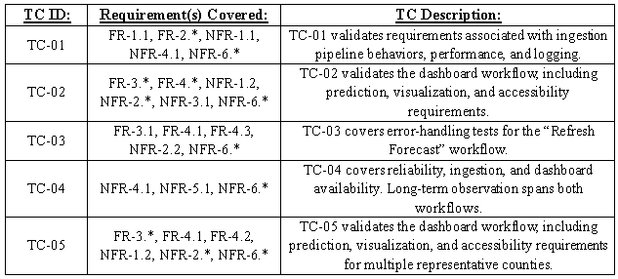

RTX-Team A
About Us
Portfolio
Contact Us
Search
Test Plan
Test Case Design
System-level, black-box techniques
ISO/IEC/IEEE Std 29119-(3): Test Documentation
ISO/IEC/IEEE Std 29119-(4): Test Techniques
Traceability
Test Case → Use Case
Test Case → FR & NFR

Slide 10
RTX-Team A
About Us
Portfolio
Contact Us
Search
Challenges & Solutions
Data Availability
Model Performance
Enhanced preprocessing
Expanded dataset
Improved feature engineering
Incremental ML development
Dashboard Usability
Workflow Efficiency
Redesigned UI
Added accessibility updates
Improved Process & Requirements Engineering

Slide 11


RTX-Team A
About Us
Portfolio
Contact Us
Search
Questions & Answers
Thank you for your time!
CLAP_V1.2 is a machine-learning-powered web application that predicts Air Quality Index (AQI) for counties across the United States. CLAP features an ML model for real-time predictive forecasting for 700+ counties across the United States, and an interactive dashboard with EPA-compliant color-coding.
This project is part of SE 4485.001 coursework at the University of Texas at Dallas.

Slide 12
RTX-Team A
About Us
Portfolio
Contact Us
Search
References
[1] Larson, E. and Gray, C., 2014. Project Management: The Managerial Process. McGraw Hill
[2] Humphrey, W.S. and Thomas, W.R., 2010. Reflections on Management: How to Manage Your Software Projects,
Your Teams, Your Boss, and Yourself. Pearson Education
[3] Signh, A. (2022). Introduction to Machine Learning Lifecycle. [Figure]. In What is machine learning lifecycle?.
NashTech. Retrieved from https://blog.nashtechglobal.com/introduction-to-machine-learning-lifecycle/
[4] Lamsweerde, A.V., 2009. Requirements Engineering: From System Goals to UML Models to Software
Specifications. John Wiley
[5] A. J. Lattanze, Architecting Software Intensive Systems. CRC Press, 2008.
[6] L. Bass, P. Clements, and R. Kazman, Software Architecture in Practice, 3rd ed. Upper Saddle River (N.J.):
Addison-Wesley, 2013.
[7] Larman, C., 2012. Applying UML and Patterns: An Introduction to Object Oriented Analysis and Design and
Iterative Development. Pearson Education
[8] Hyman, B., 1998. Fundamentals of Engineering Design. New Jersey: Prentice Hall
[9] Simon, H.A., 2014. A Student's Introduction to Engineering Design: Pergamon Unified Engineering Series (Vol. 21).
Elsevier
[10] Jorgensen, P.C., 2013. Software Testing: A Craftsman's Approach. Auerbach Publications
[11] Mathur, A.P., 2013. Foundations of Software Testing, 2/e. Pearson Education

Slide 13
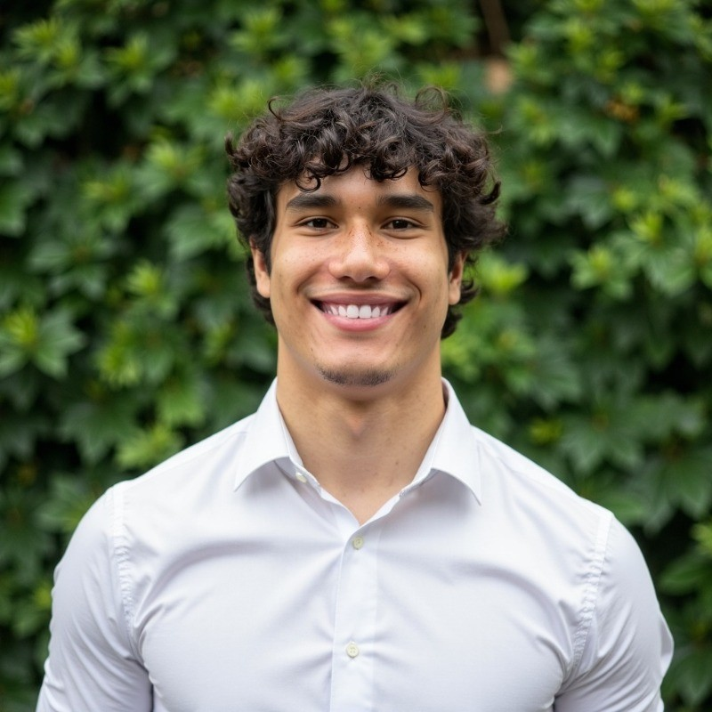
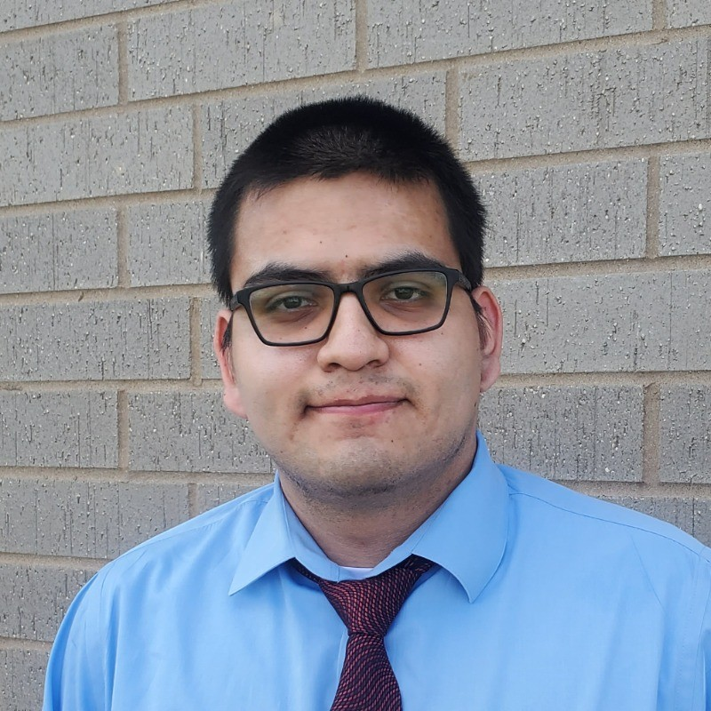



RTX-Team A
About Us
Portfolio
Contact Us
Search
Group 1
David Santos
Kevin Melo
Project Lead
Optimization
AJ Kimbrough
Amelia Quinn
Deployment
Testing & QA
Jay Chung
Andrew Enright
Model Research
UI/UX

